Slide 1
Shared Memory Machines
Presentaion about How Shared Memory machines work.

Slide 2
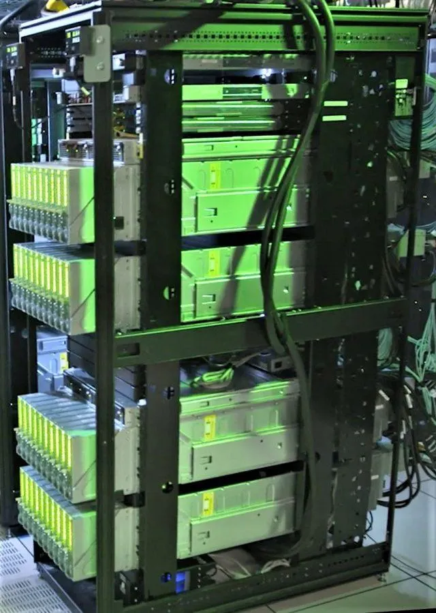
What is Shared Memory Machine Means?
Shared Memory Machines are like
a team of friends working together on a
giant puzzle.
In this setup, each friend (processor)
can directly look at and add pieces to a big table (shared memory).
Unlike puzzles where each friend has their own pieces (distributed memory),
here they all share the same set.

Slide 3
How can we Imagine SMM?
Working Together
Communication
Imagine friends sitting around a big table working (Shared memory) on different sections of the puzzle (each process).
They can easily see what others are doing and share pieces since they all use the same table.
Communication is as simple as talking or pointing to parts of the puzzle on the shared table.
Process is done with another one and shared memory like access point for each process by reading and writing

Slide 4
Types of Shared Memory Architectures?
uniform memory access (UMA)
Non-uniform memory access (NUMA)
access times to different parts of the shared memory may vary. It's like some parts of the memory are closer to specific processors, and accessing data in those areas is faster for the nearby processors.
Everyone in the library has equal access to all the books and
resources.
No matter where you sit, the time it takes to get a book is the same for everyone
each processor has equal access time to any part of the shared memory
The café has different sections, and the time it takes to get a coffee may vary depending on where you're seated.
Those sitting near the coffee counter get their coffee faster than those at a distance.

Slide 5

Scientific Definition
uniform memory access (UMA)
Non-uniform memory access (NUMA)
In shared memory multiprocessor systems, all processors access a single memory through an interconnection network, ensuring equal access time and speed
it is also known as SMP (Symmetric multiprocessor) systems.
In this model, each processor connects to dedicated memory, creating a unified address space with variable memory access times based on processor distance.
Access to any memory location is achieved using physical addresses.

Slide 6
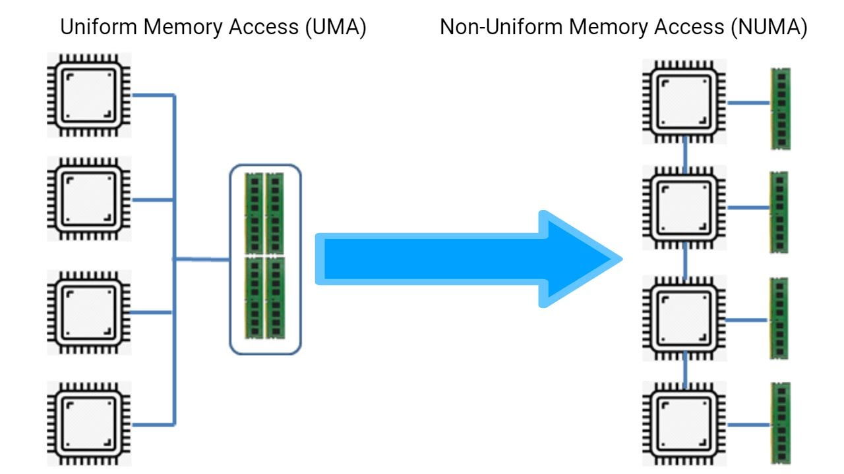

Slide 7
Features | UMA | NUMA
Full Forms | UMA is an abbreviation for Uniform Memory Access. | NUMA is an abbreviation for Non-Uniform Memory Access.
Memory Controller | It contains a single memory controller. | It contains several memory controllers.
Memory Access Time | It contains balanced or equal memory access time. | Its memory access time changes according to the distance of the microprocessor.
Memory Access | Its memory access is slow. | Its memory access is faster.
Suitability | It is mainly utilized in time-sharing and general-purpose applications. | It is mainly utilized in time-critical and real-time apps.
Bandwidth | It has limited bandwidth. | It has more bandwidth.
Bus type | It employs single, multiple, and crossbar buses. | It employs hierarchical and tree-structured buses and network connections.

Slide 8
Advantages on SMM?
Simplicity
Quick Collaboration
Sharing Resources
Working on the same
puzzle table is simpler
than managing
separate ones for each
friend.
Programming for
shared memory
systems is generally
Easier
Friends can quickly
exchange pieces and
ideas by using the
shared puzzle table
processors
communicate faster
due to direct access to
shared memory
All friends share the
same puzzle pieces,
making the best use of
Resources
Shared Memory
Machines efficiently
share data and
variables among
processors

Slide 9
Challenges faced with SMM?
Too Many Friends
(Scalability)
Programming
Complexity
If too many friends
want to use the same
puzzle table, it might
get crowded
scalability can be a
challenge in large
shared memory
systems.
Organizing who works
on what part of the
puzzle needs careful
Planning
programming for large-
scale shared memory
systems can be complex

Slide 10
Table of contents
Introduction
Cache coherence
The cache coherence protocol problem
Cache coherence protocols
Benefits of cache coherence protocols

Slide 11
Introduction
In modern computer architectures, shared memory systems have become more prevalent than ever. These systems allow multiple processors to access a common pool of memory, enabling efficient communication and data sharing.
However, shared memory introduce a challenge: maintaining cache coherence.

Slide 12
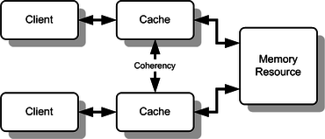
Cache coherence
Refers to the propriety of a shared memory system where all processors have a consistent view of the memory.
This means that any updates made to shared data by one processor should be visible to all other processors in a timely manner.
Without cache coherence, processors may read outdated data, leading to incorrect program behavior.

Slide 13
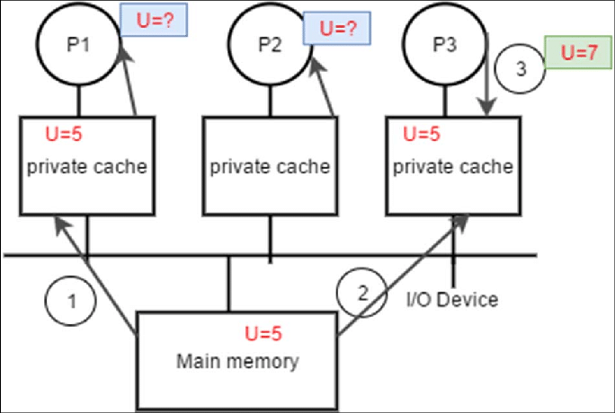
The cache coherence problem
How the cache problem happens
Due to the presence of multiple caches in shared memory, each cache stores a local copy of frequently accessed data to reduce memory access latency.
However, when one processor modifies cached data item, the copies in other caches become outdated
To maintain cache coherence, the system must ensure all cached copies of a data item become updated whenever a modification happens. This involves a communication between processors and coordination of cache operations.

Slide 14
Cache coherence protocols
The mechanisms that enforce cache coherence in shared memory systems. These rules define the rules for how processors communicate and update cached data items to maintain consistency.
There are two main categories of cache coherence protocols:
Snooping based protocols
Directory based protocols

Slide 15
Cache coherence protocols
Snooping based protocols
Directory based protocols
Processors monitor the memory bus to track cache updates performed by other processors.
When a processor observes an update to a data item that it also has cached, it takes appropriate actions to either update the copy or invalidate it.
A directory is maintained to track the state of all cached data items. The directory keeps a record of which processors have cached copies of each data item.
When a processor updates a data item, it informs the directory, which then updates the state of the corresponding cached copies.

Slide 16
Benefits of cache coherence protocols
Improved performance: Now processors can read the most up-to-date data from their caches, reducing the need to access slower main memory.
Simplified programming: programmers can write shared memory without worrying about the intricacies of cached management.
Scalability: Cache coherence protocols can be scaled to large numbers of processors.

Slide 17
Parallel algorithms for shared memory
A algorithm that can execute several instructions simultaneously on different processing devices and then combine all the individual outputs to produce the final result.
Topics to be covered
Examples
Types of Parallelism
Parallel Algorithms

Slide 18
1-Types of Parallelism
Task Parallelism Is a form of parallelization of computer code across multiple processors in parallel computing environments.
Task Parallelism focuses on distributing tasks across different processors
Task Parallelism is distinguished by performing many different tasks simultaneously on the same data
Data Parallelism is parallelization across multiple processors in parallel computing environments.
Data Parallelism focuses on distributing the data across different nodes, which operate on the data in parallel.
Data Parallelism is the simultaneous execution on multiple cores of the same function across the elements of a dataset
Each processor operates on a different subset of the data independently.

Slide 19
Comparison between Task , Data parallelism.
Advantages of Data parallelism
Efficient for large datasets.
Well-suited for operations with a high degree of parallelism
Data Parallelisms | Task Parallelisms
Same task are performed on different subsets of same data. | Different task are performed on the same or different data.
only one execution thread operating on all sets of data so the speedup is more. | each processor will execute a different thread or process on the same or different set of data. so speedup is less.
parallelization is relative to the input size. | parallelization is relative to the number of independent tasks is performed.
Advantages of Task parallelism
Suitable for applications with diverse and independent tasks.
More flexibility in handling different types of computations.
Disadvantages of Task parallelism
Dependency Management.
Complexity in Task Division.
Note : I won’t be able to talk about all the differences between task , data parallelism because it’s a very big subject to cover in 1 presentation.
Disadvantages of Data parallelism
Data Dependency.
Communication Overhead.

Slide 20
2-Parallel Algorithms
Parallel File System Operations | Parallel Task Scheduling | Parallel Memory Management | Parallel Page Replacement | Parallel I/O Operations
Parallel algorithms in file systems allow multiple threads or processes to read and write to different parts of a file simultaneously. | Parallel algorithms in task scheduling distribute the workload across multiple processors By allowing independent scheduling on different processors. | Parallel algorithms optimize this process by enabling concurrent memory allocation and deallocation by multiple processes | Enhance efficiency by allowing multiple pages to be swapped simultaneously. Multiple threads can work on different parts of the page table. | Parallel I/O algorithms enable concurrent execution of multiple I/O operations,multiple threads can handle different I/O requests simultaneously.

Slide 21
5-Examples
Parallel File System Example ➔ IBM’s Spectrum Scale :-
IBM’s GPFS/Spectrum Scale is a block-based parallel file system that uses blocks of adjustable width and dynamic metadata for information distribution
Parallel Task Scheduling Example ➔ Multi-Queue
Each queue in the multi-level structure can be viewed as a separate parallel entity. Processes within the same priority level (queue) can be scheduled concurrently, making this approach a form of parallel task scheduling
Parallel Memory Management Example ➔Buddy Memory Allocation
Memory is partitioned into blocks, and each block is paired with its buddy.
When a request for memory is made, the system allocates the smallest available block that fits the requested size. Upon deallocation, the system coalesces adjacent free blocks.

Slide 22

Synchronization and Concurrency
Syncing is a common element of our everyday interactions with other individuals. you and your spouse may need to coordinate who gets to take the car, buys the groceries, cleans up after the trash, drops the kids off at school, and uses the one computer you have. If you and your neighbor share a yard and your neighbor has a dog and you have a cat, you might want to work together to make sure that neither pet is ever in the yard at the same time.

Slide 23
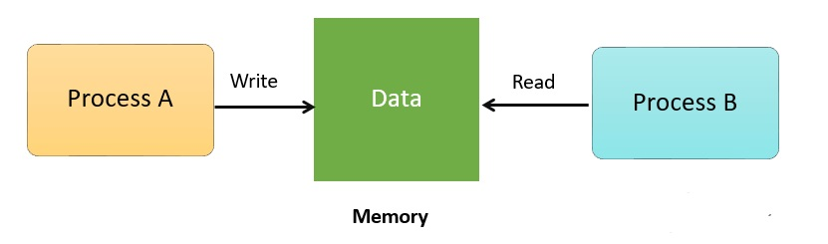
All the above examples for synchronization between people have corresponding examples for synchronization between computers. Synchronization is needed in all systems and environments where several processors can be active at the same time. Without proper synchronization, the integrity of the data may be destroyed if two computers (or processors) update a common ﬁle at the same time, and as a result, deposits and withdrawals could be lost, conﬁrmed reservations might have disappeared, etc.

Slide 24
achieving synchronization between computers (processors) is challenging and difﬁcult. The reason is that computers communicate with each other in a very restricted way.
the problem we are tying to solve is Process Synchronization.
Process Synchronization is the task of coordinating the execution of processes in a way that no two processes can have access to the same shared data and resources.

Slide 25
A concurrent system is a collection of processors that communicate by reading and writing from a shared memory. A process corresponds to a given computation. That is given some program, its execution is a process. A process runs on a processor, which is the physical hardware.
Several processes can run on the same processor although in such a case only one of them may be active at any given time. Real concurrency is achieved when several processes are running simultaneously on several processors.

Slide 26
Process Synchronization algorithms examples: -
Mutex:
short for mutual exclusion, is a synchronization primitive that allows only one process at a time to access a shared resource. It is implemented using binary semaphores with operations like wait and signal.
Monitors:
are high-level synchronization constructs that encapsulate shared data and procedures that operate on the data. Only one process can execute a procedure within a monitor at a time, ensuring exclusive access to shared resources.

Slide 27

eXtremeDB allows two or more processes in a multi-processing operating environment (for example, Linux and Windows platforms) to share a common database.

Slide 28
Overview
in order to share the data between multiple processes, the database must be created in shared memory. Multiple threads within a process share the memory of that process. The shared memory that is used by the eXtremeDB runtime is architecture and operating system dependent. In some environments, the eXtremeDB runtime uses a System V shared memory mechanism (for example, Sun Solaris and Linux) while for others it uses POSIX style shared memory. On Microsoft Windows platforms there is yet another shared memory mechanism. When the database is created, the runtime allocates two shared memory segments: one for the eXtremeDB “registry” that keeps information about all database instances created on the machine, and another segment for the data itself. All database operations are then done via eXtremeDB standard interfaces.

Slide 29
Implementation
eXtremeDB shared memory applications are different in two ways from database applications that use conventional memory:
1) they must link with the shared-memory runtime libraries, and
2) the shared database is opened in only one process while other processes simply connect to it.
The shared-memory libraries are operating system dependent and are explained in detail in the package contents pages.

Slide 30

Shared Memory Runtime Options
The eXtremeDB runtime must be informed of shared memory configuration through runtime options. The shared memory options are OS specific.
For Windows applications
There are two groups of runtime options: one for determining the scope of the shared memory block name (local or global), and one for determining the security level applied to the shared memory block. The combination of options are applied to the name specified in the shared (named) memory block device. Please see the Native Language APIs section for instructions on setting these runtime options for your development environment.

Slide 31


For Linux applications
Linux shared memory applications use the POSIX function mmap() to provide mapping of virtual shared memory to a current process.
For Unix applications
On Unix systems the shared memory access mode is specified by the Unix specific value of file system access rights. Shared memory and semaphores have the same system of permissions as ordinary files to restrict access by processes of different users and groups.

Slide 32

Shared memory on MacOS and some Linux systems
When developing eXtremeDB applications on MacOS it might be necessary to reconfigure system shared memory settings – even for applications that do not intentionally use shared memory. This is because a small amount of shared memory is allocated to processes by default. (Actually, this is not only a Mac problem; some Linux distributions have similar settings by default.)

Slide 33
To resolve this the default shared memory settings should be changed by editing (or creating) file /etc/sysctl.conf with the following settings:
kern.sysv.shmmax=1073741824
kern.sysv.shmall=262144
kern.sysv.shmmin=1
kern.sysv.shmseg=32
kern.sysv.shmmni=128

Slide 34
Native Language APIs
The APIs for shared memory applications are specific to the programming language used. Please use the links below to view detailed explanations and examples for your development environment:
C / C# / C++
Python
Java
Java Shared memory applications in Java
Python Shared memory applications in Python
Shared memory applications in C/C#/C++

Slide 35
Thanks!
Student name | ID
Mahmoud Essam Fathy | 20221460231
Abdelrahman Ashraf Ragab | 20221374041
Abdullah Hussein Ibrahim | 20221427861
Zyad Ashraf Hafez | 20221374025

